Slide 1
Chapter 3: Neurons communicate quickly

Slide 2
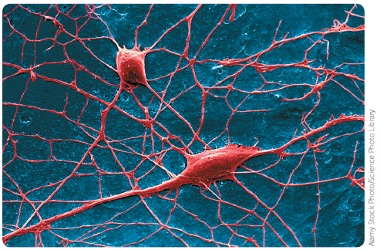
3.1 Nerve cells
The nervous system is one of the body’s two communications systems. Along with the endocrine system, it coordinates all our voluntary and involuntary actions.
The nervous system receives and processes information from sense organs and brings about responses to the information received.
Nerve cells, or neurons, are the basic structural and functional units of the whole nervous system. They are highly specialised cells perfectly designed for rapid communication of messages in the body.
Alamy Stock Photo/Science Photo Library
SEM of two nerve cells from the brain

Slide 3
3.1 Nerve cells
Structure of neurons
Neurons vary in size and shape, but they all consist of a cell body and two different types of extension from the cell – the dendrites and the axon.
Cell body
The cell body contains the nucleus and is responsible for controlling the functioning of the cell. Around the nucleus is cytoplasm containing the organelles that are found in most cells: mitochondria, endoplasmic reticulum, ribosomes and Golgi apparatus.
Dendrites
Dendrites are usually fairly short extensions of the cytoplasm of the cell body. They are often highly branched and they carry messages, or nerve impulses, into the cell body.

Slide 4
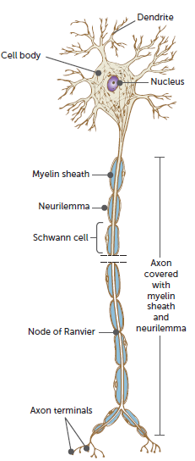
3.1 Nerve cells
Axon
The axon is often a single, long extension of the cytoplasm. It usually carries nerve impulses away from the cell body. Although usually longer than the dendrites, the length of axons varies enormously. Those in the brain may be only a few millimetres long, while the axons that run from the spinal cord to the foot may be a metre or so in length.
At its end, the axon divides into many small branches. Each of these branches terminates at the axon terminal.

Slide 5
3.1 Nerve cells
Myelin sheath
Most axons are covered with a layer of fatty material called the myelin sheath. The term nerve fibre is used for any long extension of a nerve cell, but usually refers to an axon. Those that have a myelin sheath are called myelinated fibres and those that do not are said to be unmyelinated.
Outside the brain and spinal cord, the myelin sheath is formed by Schwann cells, which wrap around the axon. At intervals along the axon are gaps in the myelin sheath, called nodes of Ranvier.
The myelin sheath has three important functions:
• It acts as an insulator.
• It protects the axon from damage.
• It speeds up the movement of nerve impulses along the axon.
In the brain and spinal cord, the myelin sheath is produced by oligodendrocytes.

Slide 6
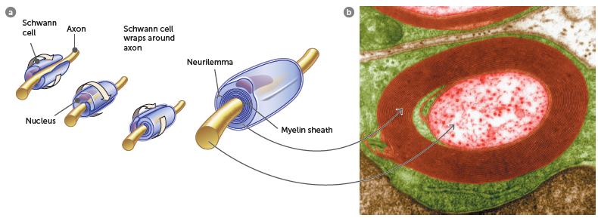
3.1 Nerve cells
Alamy Stock Photo/Science Photo Library
a Schwann cells form the sheath of a myelinated axon by wrapping around the axon. b Coloured TEM of a transverse section of a myelinated axon. The myelin sheath (brown) is formed when Schwann cells wrap around the axon and deposit layers of myelin between each coil. The outermost layer (green) is the cytoplasm of the Schwann cell – the neurilemma

Slide 7
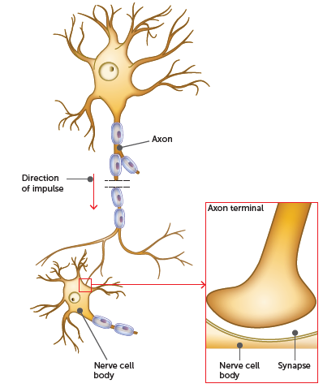
3.1 Nerve cells
Synapses
Nerve impulses have to be passed from neuron to neuron. This usually occurs where the axon terminal of one neuron joins with a dendrite or the cell body of another. This junction is called a synapse.
The neurons do not actually physically touch at the synapse; instead, there is a small gap between them. Messages have to be carried across this gap, which occurs by the movement of chemicals called neurotransmitters.
A similar synapse exists where an axon meets a skeletal muscle cell. This tiny gap is called the neuromuscular junction.

Slide 8
3.1 Nerve cells
Types of neurons
Neurons can be classified based on their function or structure.
Functional types of neurons
Sensory (also known as afferent or receptor) neurons carry messages from receptors in the sense organs, or in the skin, to the central nervous system (brain and spinal cord).
Motor (also known as efferent or effector) neurons carry messages from the central nervous system to the effectors, the muscles and glands.
Interneurons are located in the central nervous system and are the link between the sensory and motor neurons. Interneurons may also be called association neurons, connector neurons or relay neurons.

Slide 9
3.1 Nerve cells
Structural types of neurons
This classification is based on the number of extensions from the cell body.
Multipolar neurons have one axon and multiple dendrites extending from the cell body. This type of neuron is the most common and includes most of the interneurons in the brain and spinal cord as well as the motor neurons that carry messages to the skeletal muscles.
Bipolar neurons have one axon and one dendrite. Both the axon and dendrite may have many branches at their ends. Bipolar neurons occur in the eye, ear and nose, where they take impulses from the receptor cells to other neurons.
Unipolar neurons have just one extension, an axon. These types of neurons are not found in humans or other vertebrates, but in insects.
Pseudounipolar neurons have properties of both unipolar neurons and bipolar neurons. There is a single axon from the cell body, which then separates into two extensions. One extension connects to dendrites, while the other ends in axon terminals. The arrangement of the cell body and axon means that the cell body lies to one side of the main axon. Most sensory neurons that carry messages to the spinal cord are of this type.

Slide 10
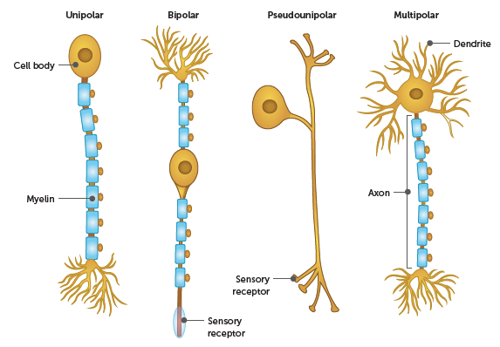
3.1 Nerve cells
Types of neurons based on their structure

Slide 11
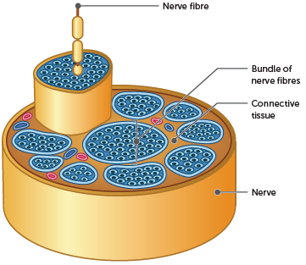
3.1 Nerve cells
Nerve fibres
The axons and dendrites of nerve cells are known as nerve fibres. Outside the brain and spinal cord, nerve fibres are grouped together to form a nerve. Nerve fibres are arranged into bundles held together by connective tissue, with multiple bundles joining together to form a nerve.
Cross-section of a nerve

Slide 12
3.2 Nerve impulses
Conduction of a nerve impulse
A nerve impulse is an electrochemical change that travels along a nerve fibre. It is described as electrochemical because it involves:
• a change in electrical voltage
• that is brought about by changes in chemicals (specifically, the concentration of ions inside and outside the cell membrane of the neuron).
Electrical charge and potential difference
Electrical charges can be positive or negative. Two positive or two negative charges repel each other. A positive and a negative charge attract each other.
When positive and negative charges come together, energy is released. If a group of positive and negative charges are separated, they have the potential to come together and release energy. The potential, or potential difference, between two places can be measured. It is called the voltage and is measured in volts (V) or millivolts (mV).

Slide 13
3.2 Nerve impulses
Potential difference across a cell membrane
When some chemical substances are dissolved in water, they break up into electrically charged particles called ions. This happens to some of the substances dissolved in the fluid around and inside cells.
• The fluid outside the cell, the extracellular fluid, contains a high concentration of sodium chloride, and so most of its charged particles are positive sodium ions (Na+) and negative chloride ions (Cl–).
• The fluid inside the cell, the intracellular fluid, has a low concentration of sodium ions and chloride ions. Its main positive ions are potassium (K+), and the negative ions come from a variety of organic substances made by the cell.
Differences in the concentration of ions mean that there is a potential between the inside and the outside of the cell membrane. This potential difference is called the membrane potential. It occurs in all body cells, but is particularly large in nerve and muscle cells. The membrane potential of unstimulated nerve cells, known as the resting membrane potential, can be measured and is about –70 mV.

Slide 14
3.2 Nerve impulses
Ions are unable to diffuse through the phospholipid bilayers of the cell membrane directly. Instead, they move through protein channels. Some channels, called leakage channels, are open all the time; others, called voltage-gated channels, only open when the nerve is stimulated.
Sodium and potassium ions also move across the cell membrane through a carrier protein known as the sodium–potassium pump. The pump moves two potassium ions into the cell for every three sodium ions that are removed. Therefore, there is a net reduction of positive ions inside the cell. This movement is against the concentration gradient and, therefore, is active transport and uses adenosine triphosphate (ATP).

Slide 15
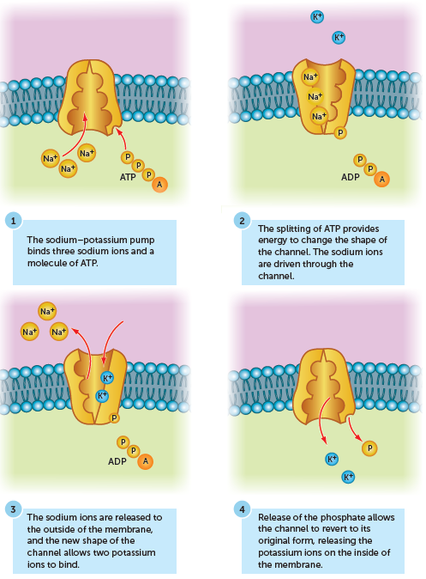
3.2 Nerve impulses
The sodium–potassium pump uses active transport to move three sodium ions out of the cell for every two potassium ions that move into the cell

Slide 16
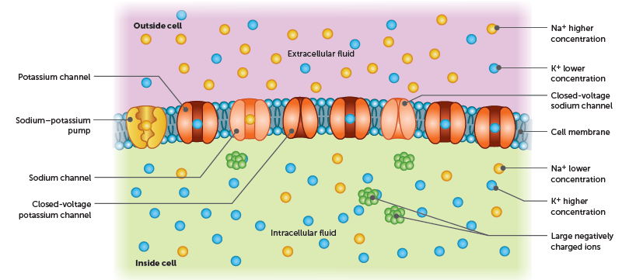
3.2 Nerve impulses
The combination of the location of the ions, the permeability of the cell membrane and the sodium– potassium pump means that there is a net flow of positive ions out of the cell because more potassium ions are diffusing out of the cell than there are sodium ions diffusing into the cell. This, in addition to the negative organic ions inside the cell, results in the inside of the cell being more negative than the outside. This produces a negative resting membrane potential, and the membrane is said to be polarised.

Slide 17
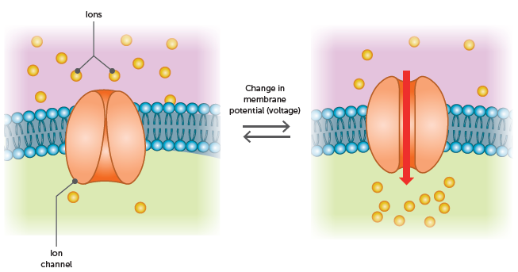
3.2 Nerve impulses
Action potential
If the stimulus to a neuron is sufficient, the signal will be passed along the neuron. This happens due to the opening and closing of voltage-gated channels, which causes the rapid depolarisation and repolarisation of the membrane. This lasts approximately 1 millisecond and is called an action potential.
Depolarisation is the sudden increase in membrane potential. This occurs if the level of stimulation exceeds about 15 mV, or the threshold.
The opening of voltage- gated sodium ion channels leads to the movement of sodium ions into the cell, increasing the membrane potential

Slide 18
3.2 Nerve impulses
After a short period, repolarisation occurs. The sodium channels close, which stops the influx of sodium ions. At the same time, voltage-gated potassium channels open, increasing the flow of potassium ions out of the cell. This makes the inside of the membrane more negative than the outside and decreases the membrane potential. The membrane is repolarised.
The potassium channels remain open longer than what is needed. This results in the membrane potential dropping lower than the resting membrane potential, and the membrane is hyperpolarised. This process is called hyperpolarisation.

Slide 19
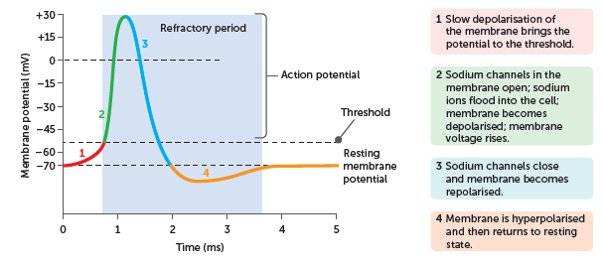
3.2 Nerve impulses
Once the sodium channels have opened, they quickly become inactivated. This means that they are unresponsive to stimulus. Therefore, for a brief period after being stimulated, the membrane will not undergo another action potential. This period, called the refractory period, lasts from when the membrane reaches the threshold of –55mV until it returns to the resting membrane potential of –70mV.

Slide 20
3.2 Nerve impulses
Transmission of the nerve impulse
A single action potential occurs in one section of a membrane. However, it triggers an action potential in the adjacent membrane. This process continues along the length of the neuron and is called a nerve impulse.
Conduction along unmyelinated fibres
In an unmyelinated nerve fibre, depolarisation of one area of the membrane causes a movement of sodium ions into the adjacent areas. This movement stimulates the opening of the voltage-gated sodium channels in the next part of the membrane, which initiates an action potential in that area of the membrane.
The process repeats itself along the whole length of the membrane so that the action potential moves along the membrane away from the point of stimulation.

Slide 21
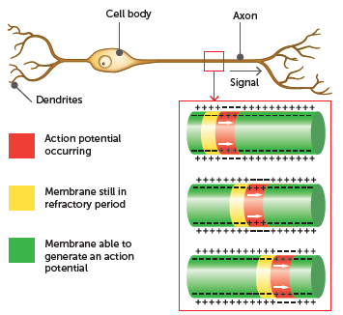
3.2 Nerve impulses
Transmission of a nerve impulse along an unmyelinated fibre. Successive action potentials are generated along the membrane of the nerve fibre

Slide 22
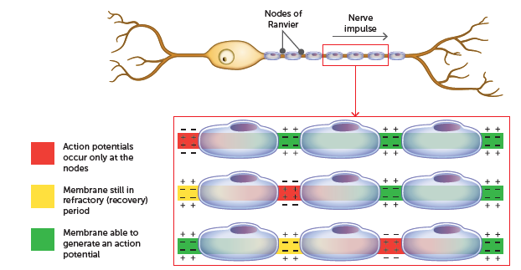
3.2 Nerve impulses
Transmission along myelinated fibres
In a myelinated fibre, the myelin sheath insulates the nerve fibre from the extracellular fluid. This does not occur at the nodes of Ranvier because the myelin sheath is absent from the nodes. Therefore, where the nerve fibre is surrounded by myelin, ions cannot flow between the inside and outside of the membrane and an action potential cannot form. Instead, the action potential jumps from one node of Ranvier to the next. This ‘jumping conduction’, known as saltatory conduction, allows the nerve impulse to travel much faster along myelinated fibres than along unmyelinated ones.

Slide 23
3.2 Nerve impulses
Size of the nerve impulse
A nerve impulse that travels along a fibre is always the same size, regardless of the size of the stimulus. A weak stimulus, provided it exceeds the threshold, produces the same action potential as a strong one. This is called an all-or-none response – a stimulus is either strong enough to trigger an impulse, or it is not. The magnitude of the impulse is always the same.
Two things enable us to determine the strength of a stimulus: a strong stimulus causes depolarisation of more nerve fibres than a weak stimulus; and a strong stimulus produces more nerve impulses in a given time than a weak stimulus.

Slide 24
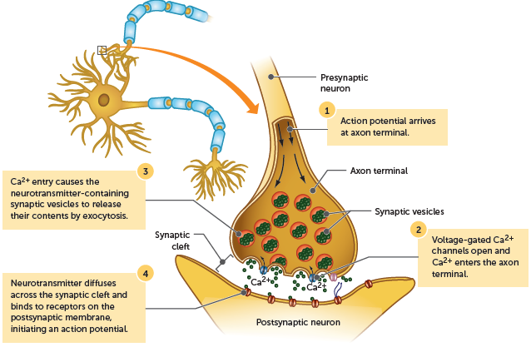
3.2 Nerve impulses
Transmission across a synapse
The synapse is the very small gap between adjacent neurons. Nerve impulses travel from one neuron to the next by neurotransmitters diffusing across the synapse.
Boundless.com. CC BY-SA 4.0 attribution licence

Slide 25
3.2 Nerve impulses
Effect of chemicals on the transmission of nerve impulses
There are many chemicals that influence the transmission of nerve impulses, mostly at the synapse or at the neuromuscular junction. Stimulants such as caffeine and benzedrine stimulate transmission at the synapse. Other drugs, such as anaesthetics or hypnotics, depress the transmission. Venom from certain species of snakes and spiders also affects the neuromuscular junction.
Nerve agents (also called nerve gases) contain organophosphates, which cause the build-up of acetylcholine at the neuromuscular junction. All muscles in the body then try to contract and the loss of muscle control prevents breathing. Organophosphates are also used in some insecticides.

Slide 26
3.3 Receptors and reflexes
A receptor is a structure that is able to detect a change in the body’s internal or external environment. When a receptor is stimulated, the body is able to respond to the change.
Types of receptors
There are different types of receptors to be able to detect the different types of stimuli.
Thermoreceptors are located in the skin and hypothalamus and respond to heat and cold and allow us to regulate body temperature
Osmoreceptors are located in the hypothalamus and respond to osmotic pressure, allowing the body’s water content to be maintained
Chemoreceptors are present in the nose (sensitivity to odours), mouth (sensitivity to taste), and in certain blood vessels, which are involved in the regulation of the heartbeat and breathing

Slide 27
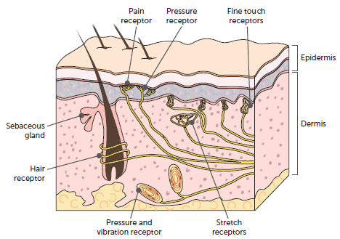
3.3 Receptors and reflexes
Cont…
Touch receptors are found mainly in the skin. Some are close to the surface of the skin and are sensitive to very light touch (e.g. lips, fingertips). Other touch receptors are located deeper in the skin and are sensitive to pressure and vibrations.
Pain receptors are stimulated by damage to the tissues, such as from a cut, by poor blood flow to a tissue, or by excessive stimulation from stimuli such as heat or chemicals. The receptors for pain are especially concentrated in the skin and the mucous membranes. They occur in most organs, but not in the brain.

Slide 28
3.3 Receptors and reflexes
Reflexes
A reflex is a rapid, automatic response to a change in the external or internal environment. All reflexes have four important properties.
A stimulus is required to trigger a reflex – the reflex is not spontaneous.
A reflex is involuntary – it occurs without any conscious thought.
A reflex response is rapid – only a small number of neurons are involved.
A reflex response is stereotyped – it occurs in the same way each time it happens.
Protective reflexes are present from birth.
Learnt reflexes
More complex motor patterns appear during a baby’s development, including reflexes such as suckling, chewing or following movements with the eyes. These innate reflexes are determined genetically.
Some complex motor patterns are learnt and are called acquired reflexes, e.g. Muscular adjustments required to maintain balance while riding a bike.

Slide 29
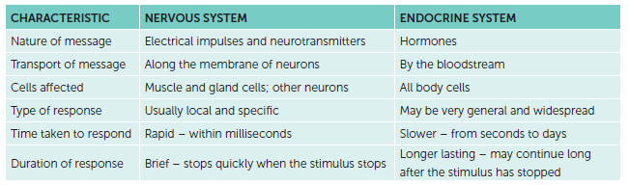
3.4 Comparison of hormonal and nervous coordination
Both the endocrine system and the nervous system are involved in communication within the body. However, they do not duplicate each other’s roles; rather, they complement and reinforce each other.
Comparison of the nervous and endocrine systems

